Slide 1
SRIRAM ENGINEERING COLLEGE SCHOOL OF COMPUTER SCIENCE AND ENGINEERING
TEAM MEMBERS:
1.Archana.A - Reg.No:112621104001
2.Keerthana.B - Reg.No: 112621104011
3.Venmathi.R - Reg.No: 112621104024
PROJECT GUIDE:
Ms. S. Sowmiya – Asst.professor/AI&DS

Slide 2
TITLE OF THE PROJECT
STUDENTS LISTENING PREDICTION IN CLASS USING DJANGO- FRAMEWORK .

Slide 3
Literature Review:
B. Wilson, M. Thomas, and K. Green, "A Review of Plagiarism Detection Techniques Using Natural Language Processing," International Journal of Computer Science and Information Security (IJCSIS), vol. 18, no. 4, pp. 112-125, 2023.
A. Smith, J. Johnson, and L. Miller, "Machine Learning for Predicting Student Engagement in Online Education," Journal of Educational Technology, vol. 25, no. 2, pp. 67-80, 2022.
S. Kumar, M. Patel, and R. Desai, "Real-Time Face Recognition Using Deep Learning for Enhanced Student Interaction," Journal of Image Processing and Computer Vision, vol. 20, no. 1, pp. 45-59, 2021.
P. Chen and J. Zhang, "Eye Tracking Technology in Education: A Review of Current Applications," Educational Psychology Review, vol. 36, no. 3, pp. 209-222, 2021.
M. Turner and H. Lewis, "Automated Analysis of Student Engagement in Virtual Learning Environments Using Facial Expressions," International Journal of AI in Education, vol. 24, no. 1, pp. 80-91, 2022.

Slide 4
Existing System:
Many educational institutions use Learning Management Systems (LMS) like Moodle, Canvas, or Blackboard to track student engagement through attendance, participation in discussions, and assignment submissions.
Various academic studies have developed machine learning models to predict patterns and trends in student behavior, allowing educators to intervene when students are likely to disengage.
Django-based applications that focus on specific aspects of student engagement, can provide dashboards for educators to visualize student engagement metrics and generate reports.

Slide 5
Proposed System:
Machine Learning Algorithm: LSTM(Long-Short Term Memory) a type of recurrent neural network (RNN) designed to learn from sequences of data.
Database: MySQL to store student data, engagement metrics, and model predictions , ensuring data integrity and security through proper database management practices.
Frontend: HTML, CSS, and JavaScript frameworks (e.g., React or Bootstrap) for a seamless user experience which include features such as dashboards, reports, and real-time feedback mechanisms.
Backend: Django as the backend framework to handle data processing, model integration, and user management.

Slide 6
ABSTRACT:
The increasing adoption of online education has highlighted the importance of monitoring student engagement to enhance the learning experience. Traditional methods of evaluating student engagement, such as participation rates or post-class surveys, often fail to capture real-time, in-depth interactions. This project proposes an advanced system that leverages Machine Learning and Image Processing techniques to predict student engagement levels during live classes. The system analyzes physical indicators, such as facial expressions and eye movement, to assess attentiveness and emotional state in real-time.
By employing facial recognition and eye tracking, the system continuously monitors the student's focus and emotional response during the session, providing insights into their engagement levels. The system offers personalized feedback and suggestions to both students and instructors, aiming to improve student participation and class dynamics. By automatically detecting disengagement cues, such as signs of boredom or distraction, it can prompt interventions like providing breaks or encouraging more interactive activities. The project’s goal is to provide a solution for real-time engagement tracking, thereby optimizing the educational experience for both students and instructors.

Slide 7
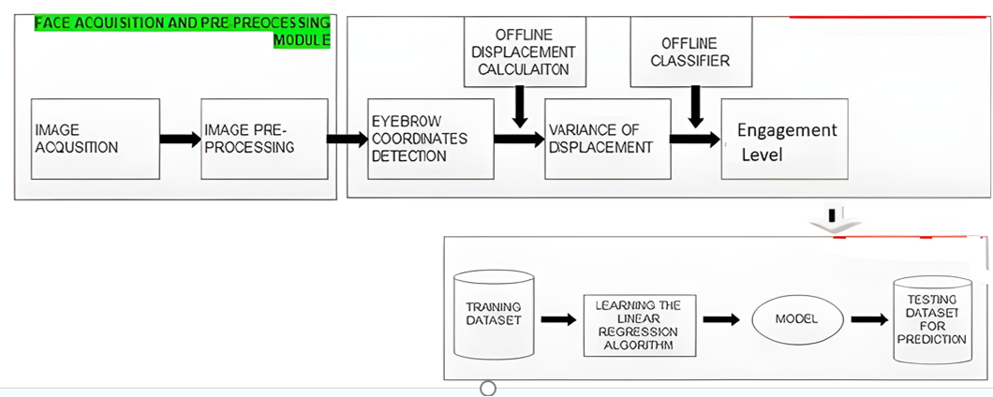
BLOCK DIAGRAM:
In Django applications, image acquisition is commonly done through user uploads via forms or REST APIs. Django provides robust support for file uploads with models using Image Field and forms that handle file input, ensuring smooth handling of image data from clients.
Image preprocessing may involve removing noise, enhancing edges, or performing color space transformations to improve image quality and algorithm performance. Proper preprocessing also helps reduce storage size and ensures consistent input for AI models.

Slide 8
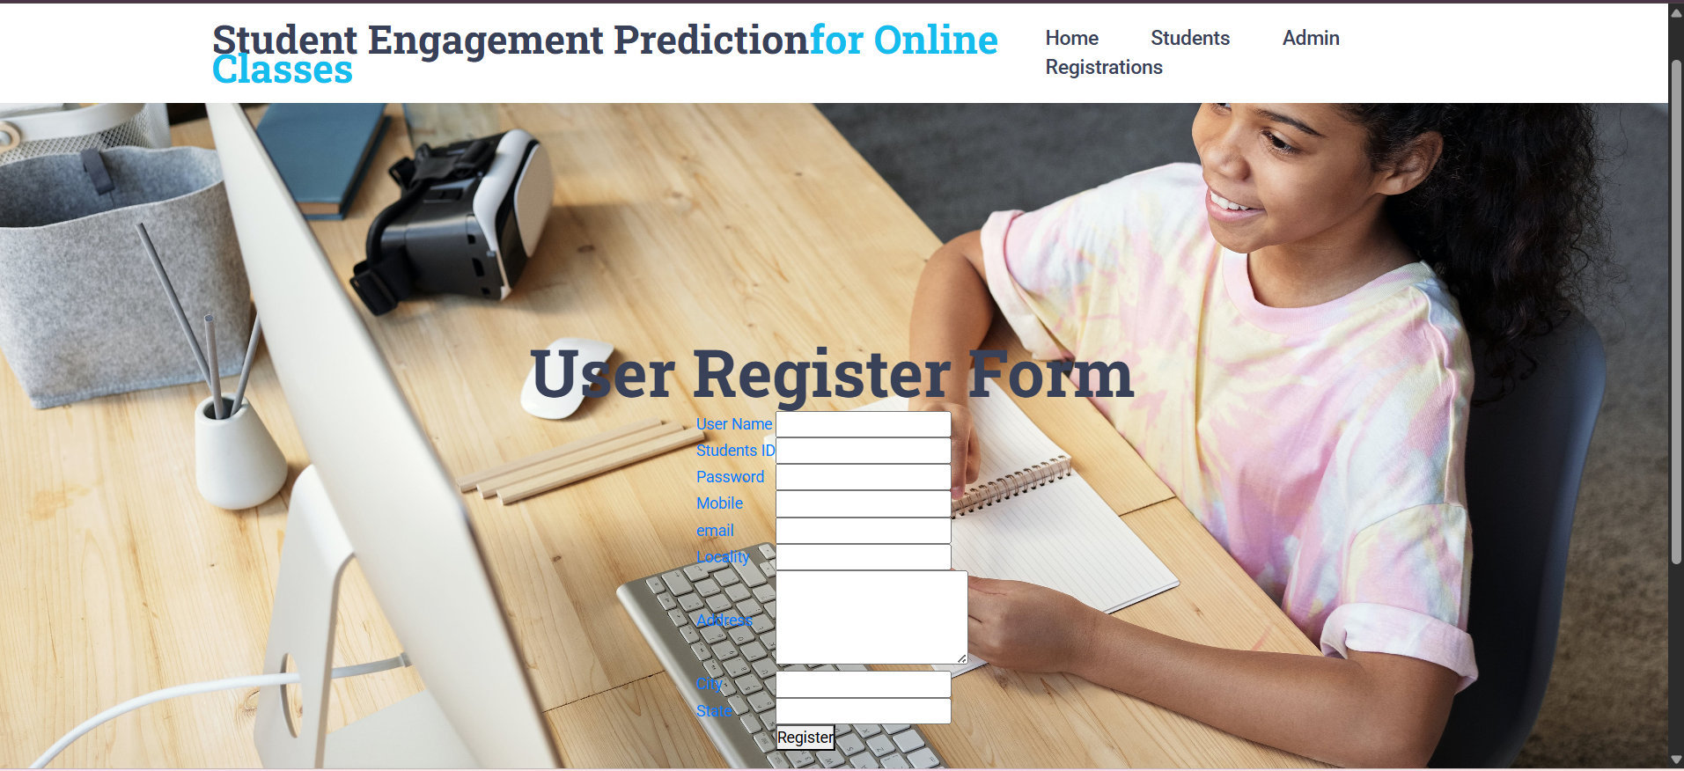
Working of the Proposed System:
FRONTEND: USER INTERFACE
1.User -Registration

Slide 9
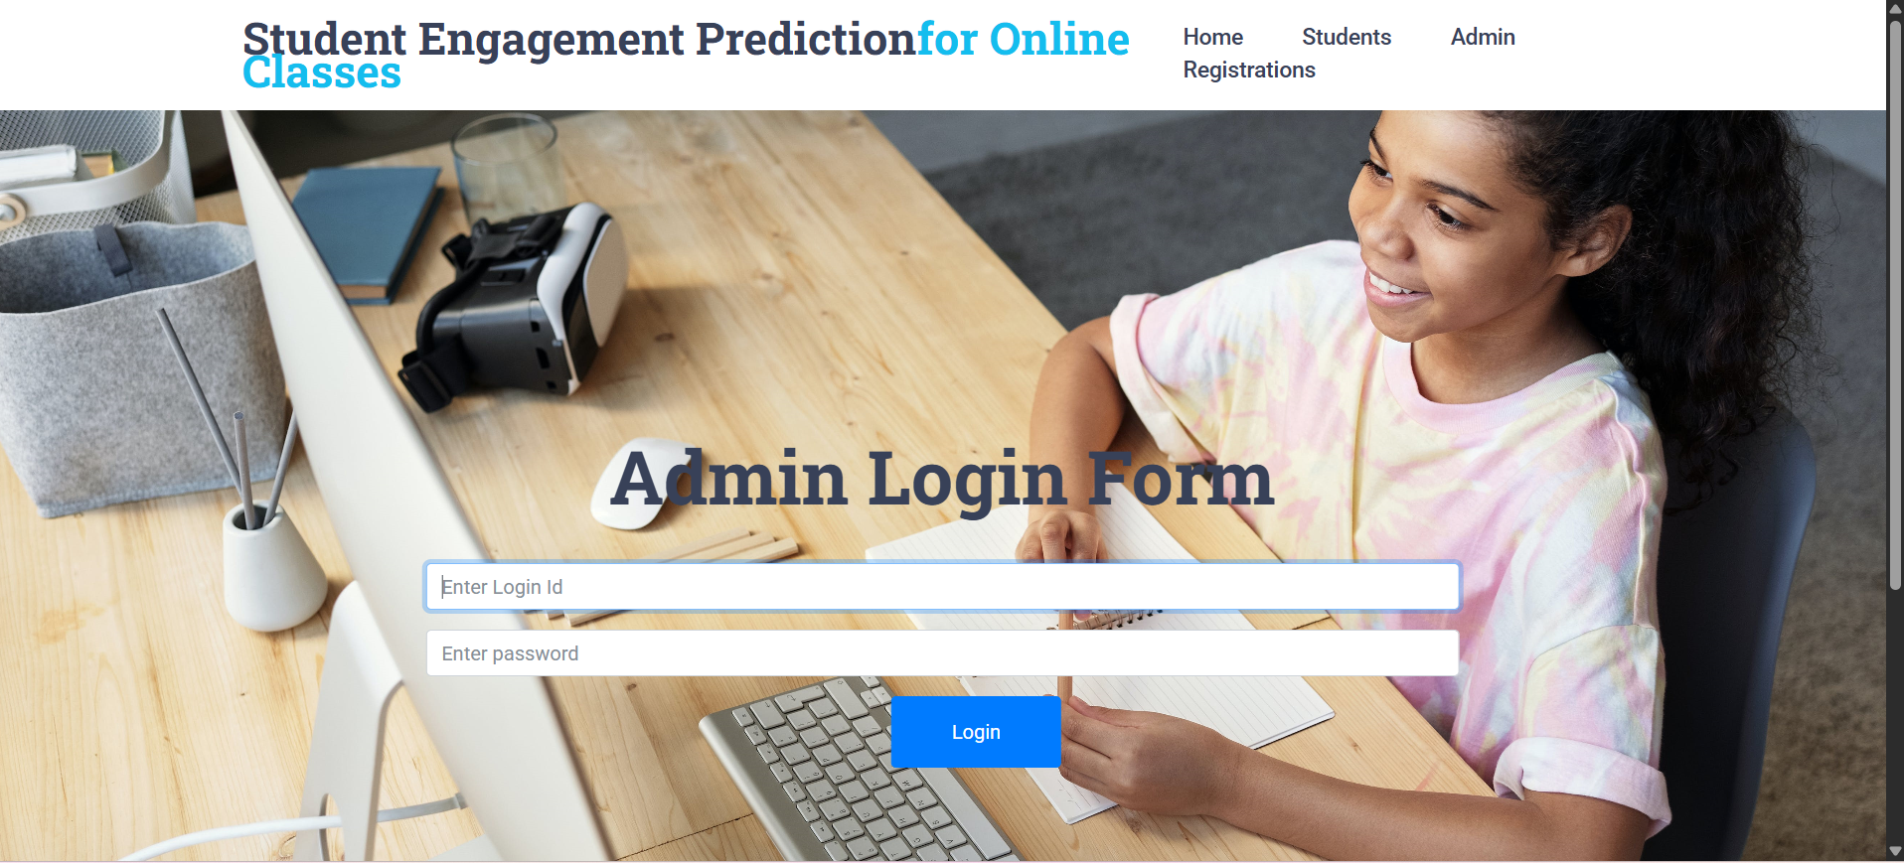
Admin Authentication:
2.Admin -Login

Slide 10
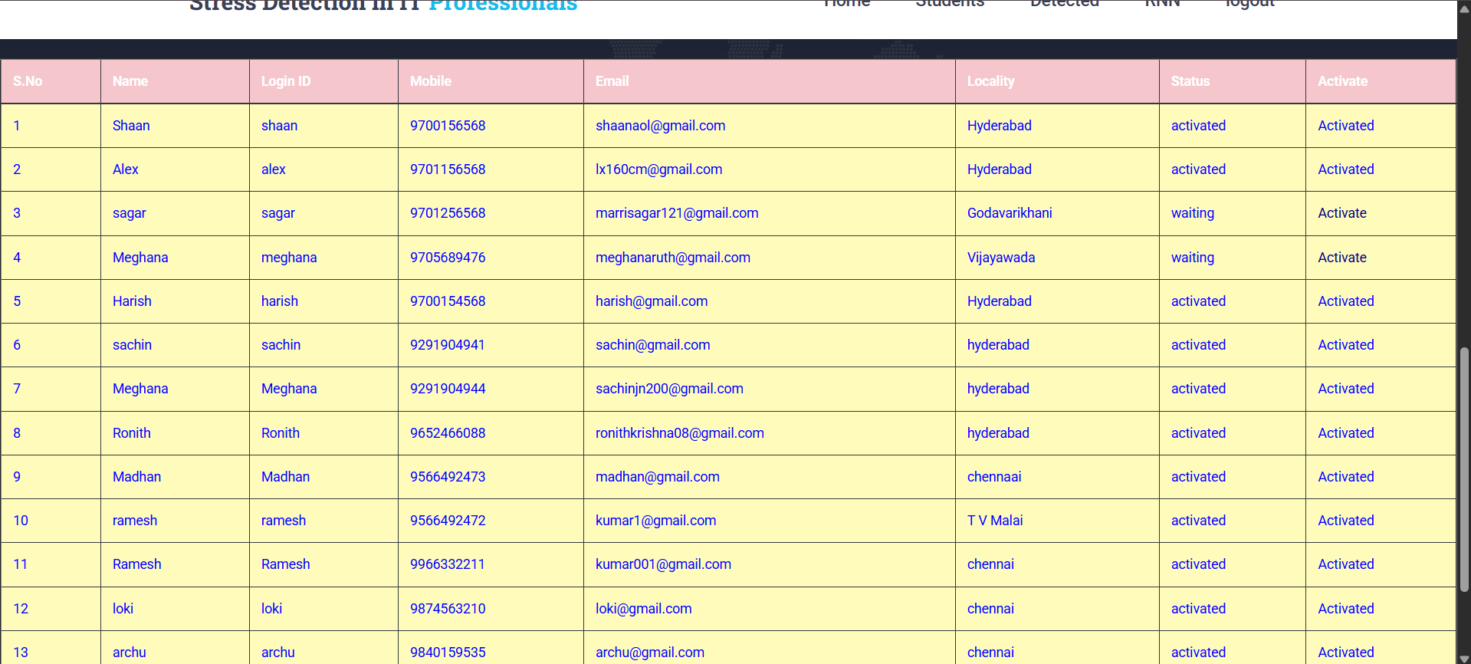
Admin Authentication:

Slide 11
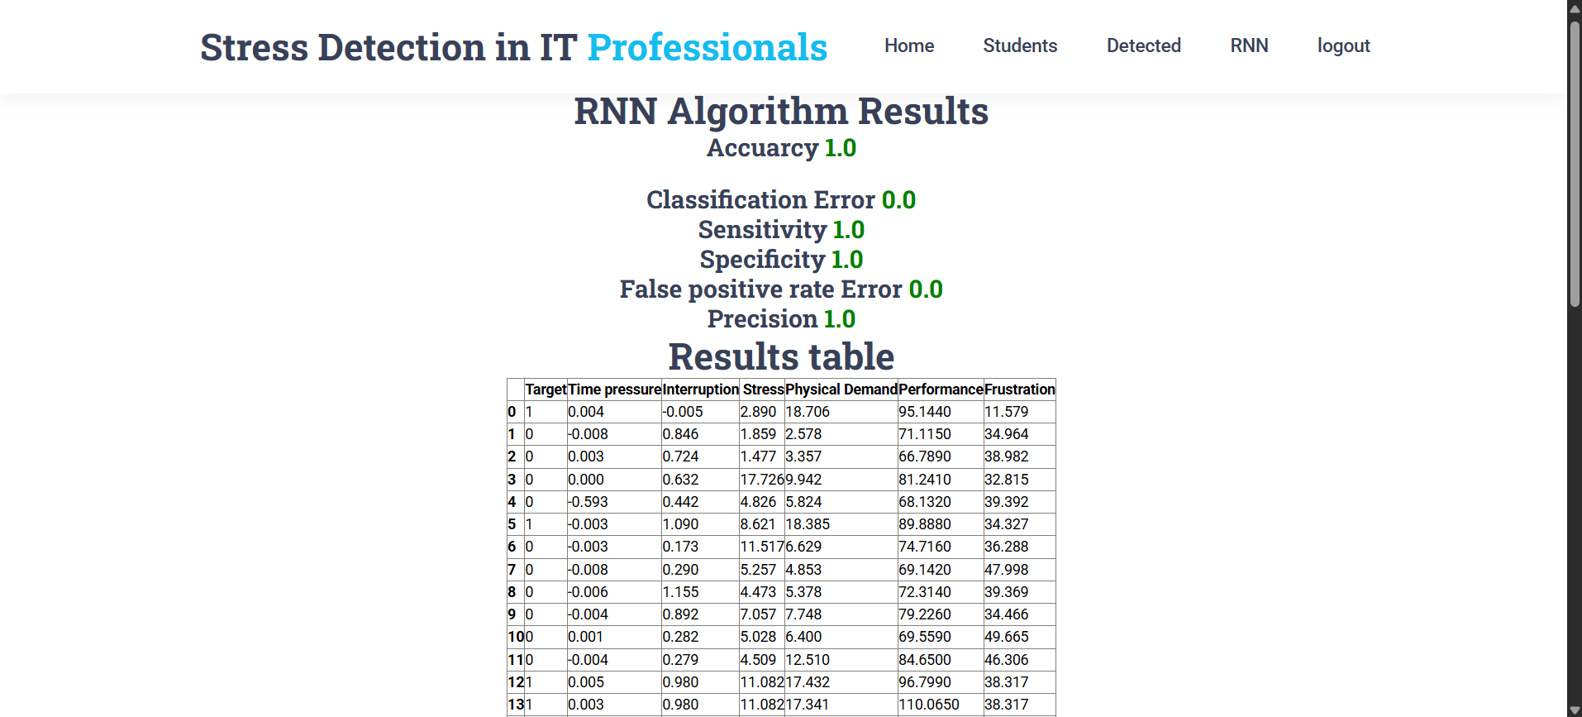
Admin Authentication:

Slide 12
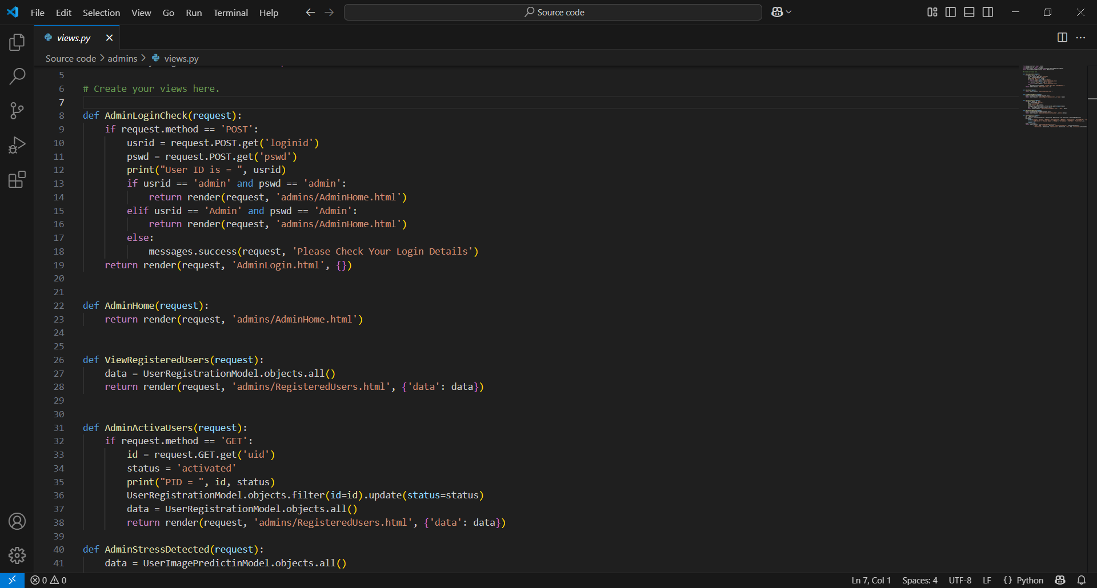
BACKEND: PYTHON

Slide 13
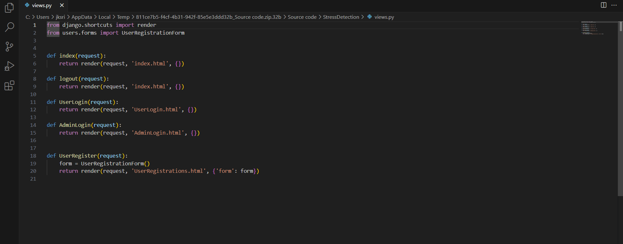
DJANGO FRAMEWORK:

Slide 14
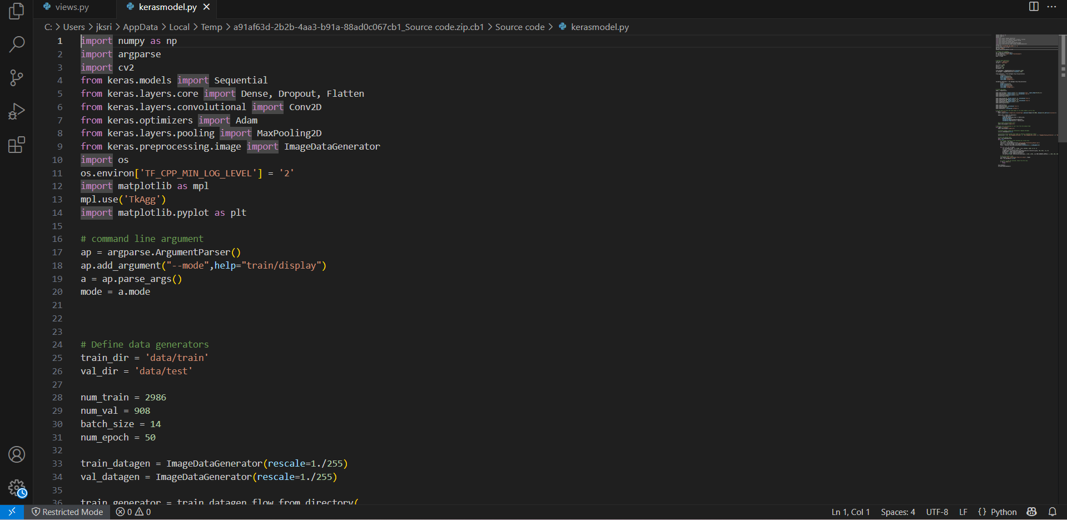
IMAGE PROCESSING AND ACQUISTION: KERAS MODEL

Slide 15
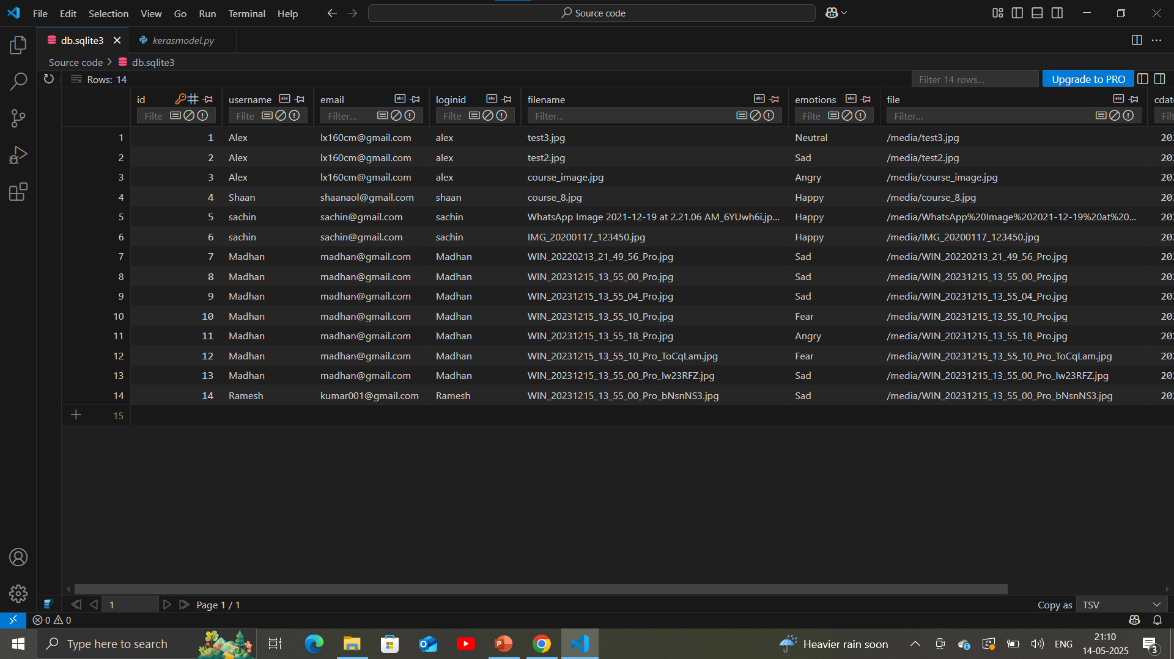
DATABASE TEST AND TRAINED DATA :

Slide 16
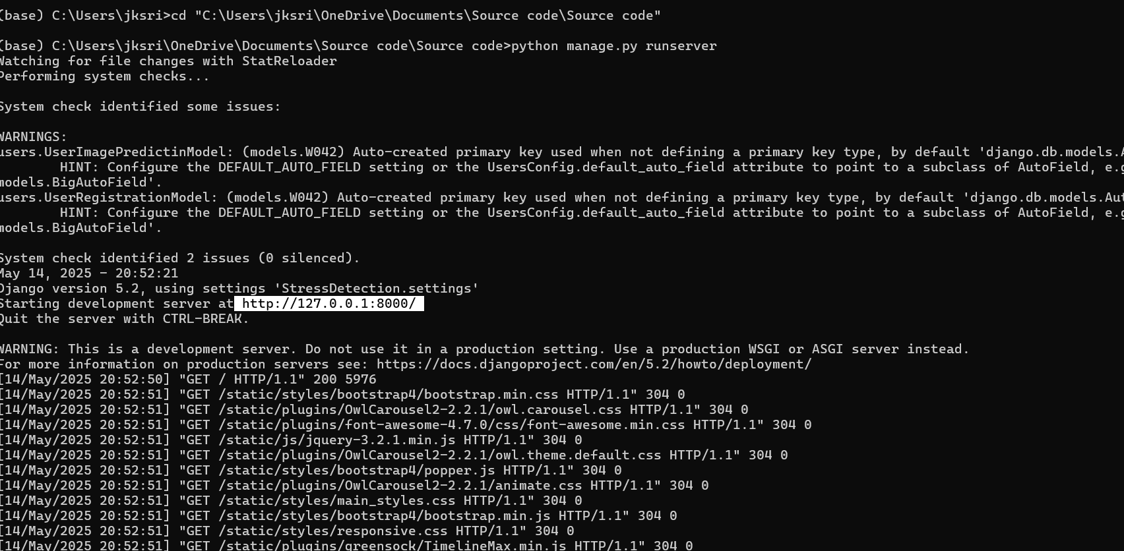
OUTPUT:

Slide 18
REFERENCES:
N. Green, L. Zhang, and A. Yu, "Implementing Real-Time Engagement Detection in Virtual Learning Environments," International Journal of Computer-Assisted Learning, vol. 18, no. 4, pp. 192-205, 2020.
R. Zhao and W. Li, "Behavioural Signal Processing for Engagement Detection in Educational Settings," Journal of Behavioural Psychology, vol. 35, no. 4, pp. 245-258, 2020.
L. Parker and G. Hamilton, "A Review of Techniques for Tracking Attention and Engagement in Online Education," International Journal of Learning Technologies, vol. 26, no. 2, pp. 112-126, 2022.
T. Walker, S. Davis, and A. Clark, "Machine Learning Approaches for Engagement Detection in E-Learning Platforms," Journal of Educational Systems and Technology, vol. 20, no. 5, pp. 223-235, 2021.
J. Brown and P. White, "A Machine Learning Framework for Predicting Student Performance in Real-Time," Educational Data Science Journal, vol. 13, no. 5, pp. 200-213, 2021.

